Slide 1

House Price Prediction Using Regression Techniques
Data Analysis and Regression
Professor:
Jamshid Sourati
Group 8:
Swetha Manupati
Varshini Sherapur Basavarajappa
Vinisha Recharla Purushotham
Shyam Sundar Theerdhala
Anirudh Tedlapally

Slide 2
Problem Statement :
Buying a home is one of the biggest financial decisions people make, but the housing market can be complicated and unpredictable. Home prices vary based on many factors, including property size, location, and amenities.
Homebuyers often struggle with transparency, negotiating with agents, and fears of overpaying.
Real estate developers and sellers need reliable pricing tools to set competitive property prices based on market trends and property features.
Our project aims to create a House Price Prediction Model using regression to accurately predict prices based on factors like size, rooms, amenities, and location.
This will help homebuyers make better decisions, find affordable homes, and assist sellers and developers in setting competitive prices using real data.

Slide 3
Overview :
Problem Statement
About Dataset
Data Preprocessing
Exploratory Data Analysis (EDA)
Data Transformation
Data Modeling :
  Simple Linear Regression,
  Multiple Linear Regression,
  Polynomial Linear Regression,
  Lasso Regression,
  Ridge Regression.
Model Evaluation
Multicollinearity & VIF
Residual Analysis and ANOVA
Conclusion and Future Scope
References

Slide 4
Dataset Description
Data Set Name: Housing Price Prediction
Source: Housing Price Prediction | Kaggle
Sample Size: 545 records
Total Variables: 13 variables (12 independent and 1 dependent)
Dependent Variable (Target):
Price: The price of the house, representing the house price we aim to predict.

Slide 5
Features :
Independent Variables (Predictors):
Area: Total area of the house in square feet.
Bedrooms: Number of bedrooms in the house.
Bathrooms: Number of bathrooms in the house.
Stories: Number of stories/floors in the house.
Mainroad: Whether the house is on a main road (Yes/No).
Guestroom: Presence of a guest room (Yes/No).
Basement: Whether the house has a basement (Yes/No).
Hot Water Heating: Availability of hot water heating (Yes/No).
Air Conditioning: Availability of air conditioning (Yes/No).
Parking: Number of parking spaces available.
Prefarea: Whether the house is in a preferred area (Yes/No).
Furnishing Status: Level of furnishing (Fully Furnished, Semi-Furnished, or Unfurnished).

Slide 6
Variable Types and Distributions
Categorical Variables: Have distinct categories or labels
Mainroad: Yes/No
Guestroom: Yes/No
Basement: Yes/No
Hot Water Heating: Yes/No
Air Conditioning: Yes/No
Prefarea: Yes/No
Furnishing Status: Fully Furnished, Semi-Furnished, Unfurnished
Numerical Variables: Represent measurable quantities
Area: Continuous (Square feet)
Bedrooms: Discrete (Number of bedrooms)
Bathrooms: Discrete (Number of bathrooms)
Stories: Discrete (Number of stories)
Parking: Discrete (Number of parking spaces)

Slide 7
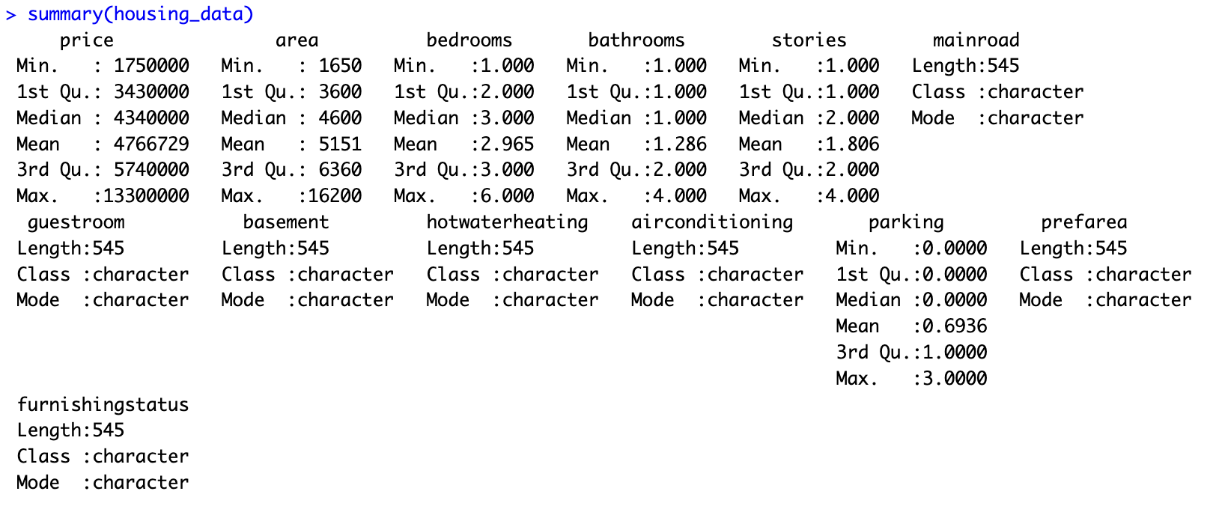
Dataset statistical values

Slide 8
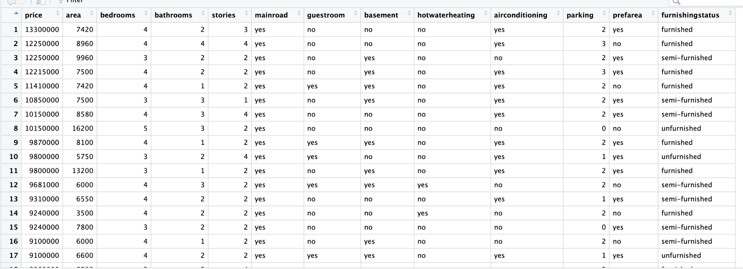
Dataset

Slide 9
Data Preprocessing:
Data Preprocessing is the process of cleaning, transforming, and organizing raw data into a usable format to improve the accuracy and performance of the models.
Data Cleaning: Remove duplicate records.
Check for inconsistencies in data entries.
Ensure data types are consistent
Handling Missing Values : Identify missing data.
Fill missing values using imputation
mean, median, mode or remove records.
Duplicates: Identify and remove duplicate records in the dataset to ensure unique and accurate data.
Null Values : Identify and handle missing null values through imputation or removal to avoid skewing results.

Slide 10
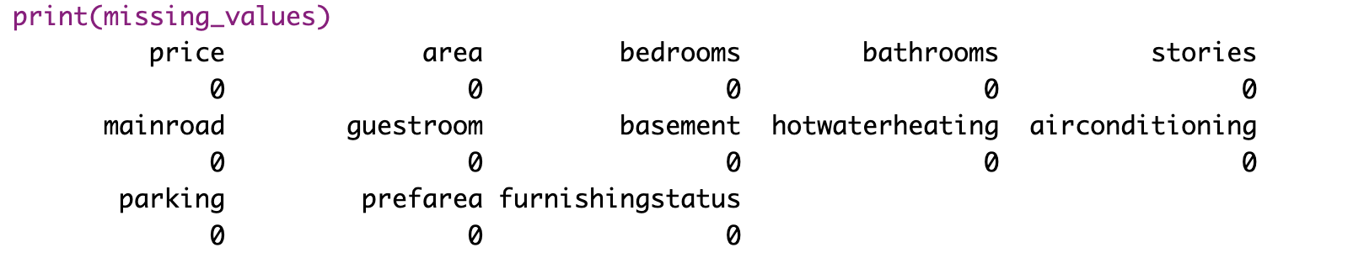
Data Preprocessing
Our dataset doesn’t have NULL values, duplicates or missing values. The dataset is clean

Slide 11
Data Encoding:
Yes/No Encoding: Convert binary variables into 0 or 1.
Furnishing Status Encoding: Convert categories
(Fully Furnished, Semi-Furnished, Unfurnished) into numerical values.
Data Standardization
Scaling Numeric Features: Standardize numerical features e.g : Area, Bedrooms, Parking.
Use Min-Max Scaling or Standardization.

Slide 12
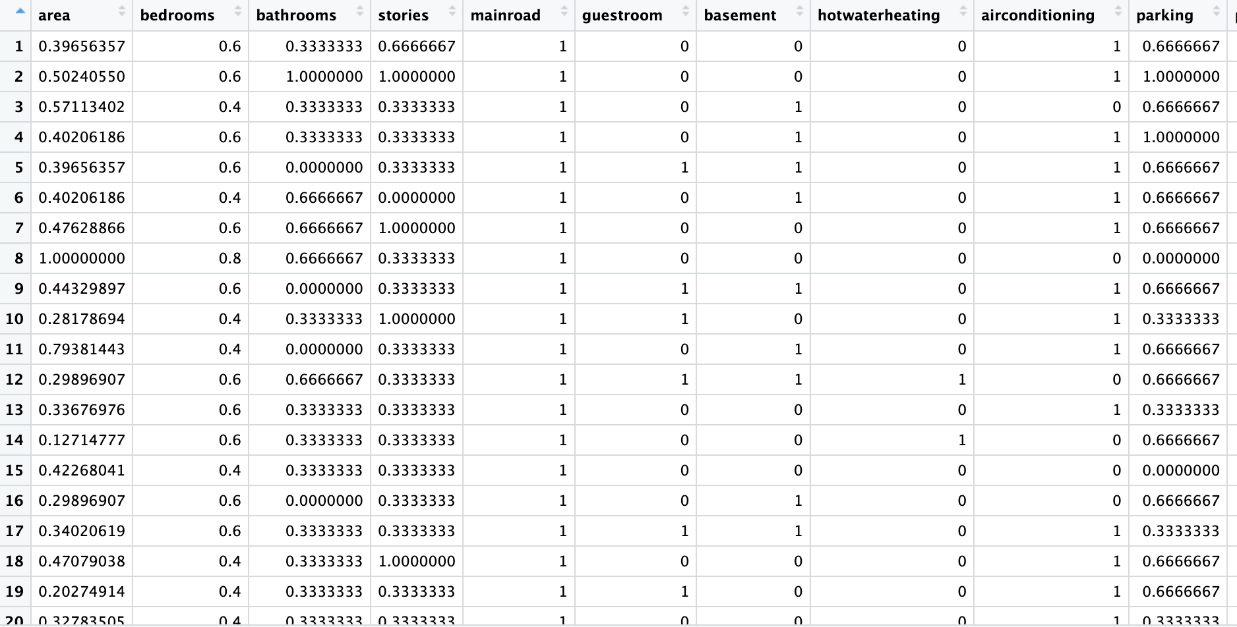
Data Encoding and Data Standardization

Slide 13
Exploratory Data Analysis
Exploratory Data Analysis (EDA) is the process of analyzing and visualizing data distributions, identifying patterns, detecting outliers, and investigating relationships between features to uncover key insights. It prepares the data for predictive modeling by identifying influential features, understanding feature correlations, and ensuring data quality for accurate analysis and model performance.

Slide 14
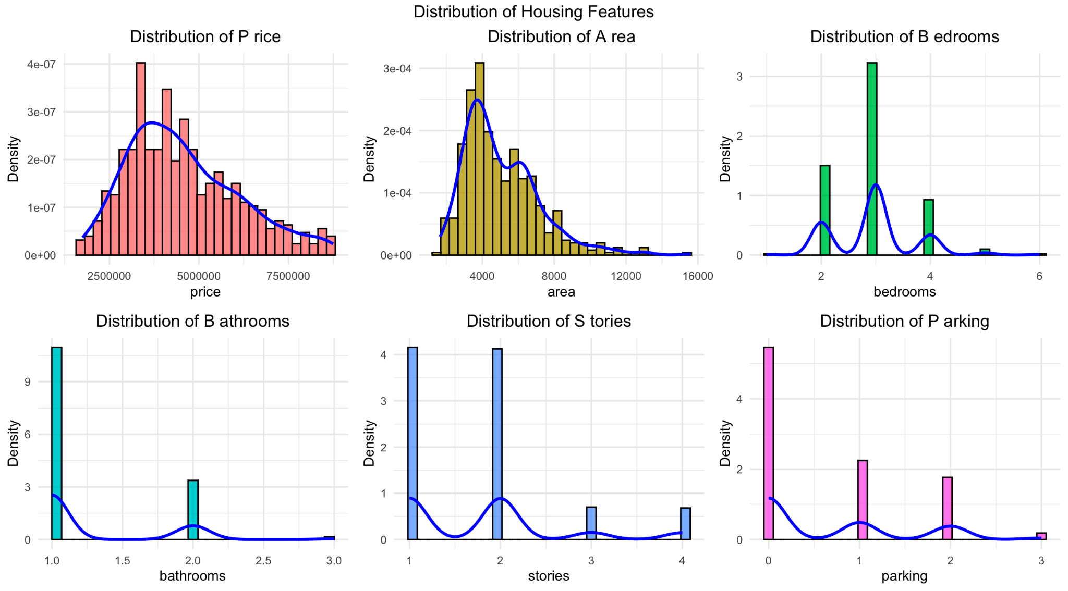
Data Distributions

Slide 15
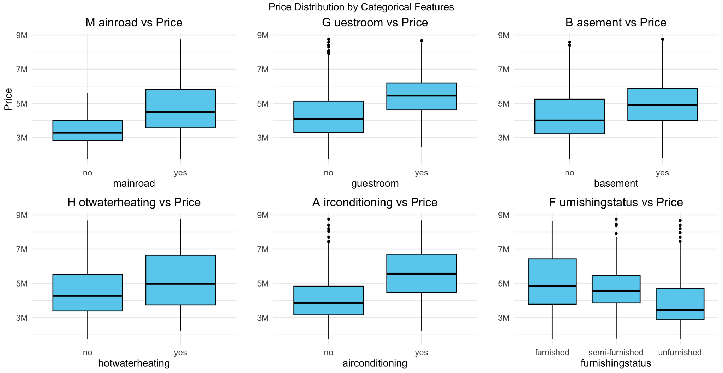
Box plots

Slide 16
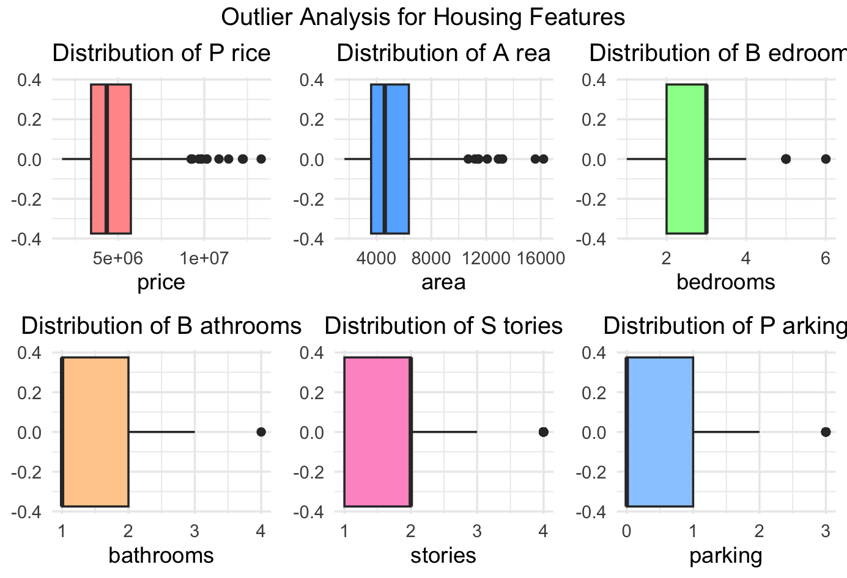
Box plots of numerical data for outliers

Slide 17
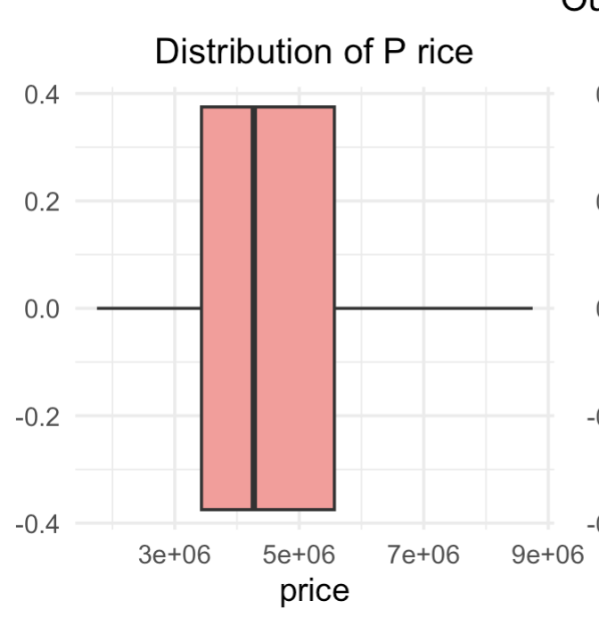
Outlier Removal

Slide 18
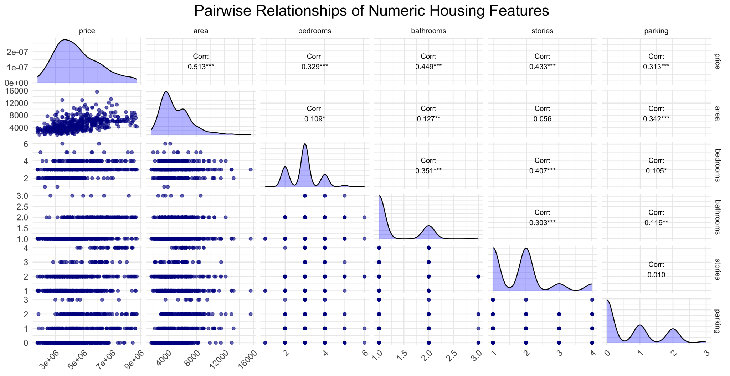

Slide 19
Data Transformation is the process of converting data from its original format or scale into a more suitable form for analysis. This can involve normalizing, scaling, or transforming variables to meet the assumptions of statistical models or to improve the interpretability of data.
Data Transformation

Slide 20
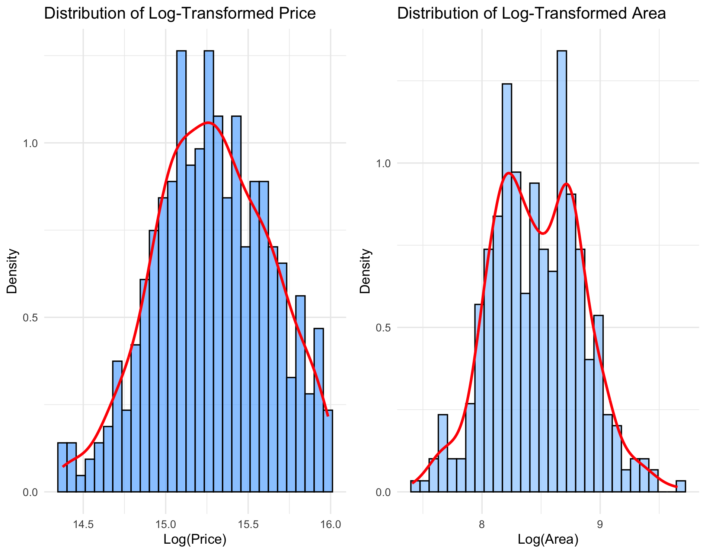

Slide 21
Regression Techniques :
Types of Regression Techniques
>> Simple Regression: Finds a straight-line relationship between input and output.
>> Multiple Linear Regression: Uses several features to predict an outcome.
>> Quadratic Regression: A type of polynomial regression that fits data to a parabolic curve
>> Polynomial Regression: Captures curved relationships by adding powers of features.
>> Ridge & Lasso Regression: Adds penalties to reduce complexity; Lasso also performs feature selection.

Slide 22
Simple linear Regression
Simple Linear Regression is a basic statistical method used to model the relationship between two variables:
One predictor (independent variable): This is the variable that we believe might explain or influence the outcome(e.g area).
One target (dependent variable): This is the outcome we want to predict or understand (e.g:price).
Purpose: Predicts house price based on a single factor - area.
Limitations: Only considers one predictor (area); other factors ex: bathrooms, parking are ignored.May not capture complex relationships in data where multiple features impact price.
Use Case: Good for understanding the direct impact of area on price but limited for full price prediction.

Slide 23
Multiple Linear Regression
Purpose of Multiple Regression
Predicting with Multiple Factors: Estimates an outcome (e.g., house price) by considering multiple features together, like area, bedrooms, and bathrooms.
Isolates Each Factor’s Effect: Measures how each predictor impacts the outcome while keeping other predictors constant.
Creates a Combined Formula: Uses a formula with coefficients for each predictor, showing their importance in predicting the outcome.
Captures Complex Relationships: Accounts for how factors may interact, giving a complete picture of what influences the outcome.

Slide 24
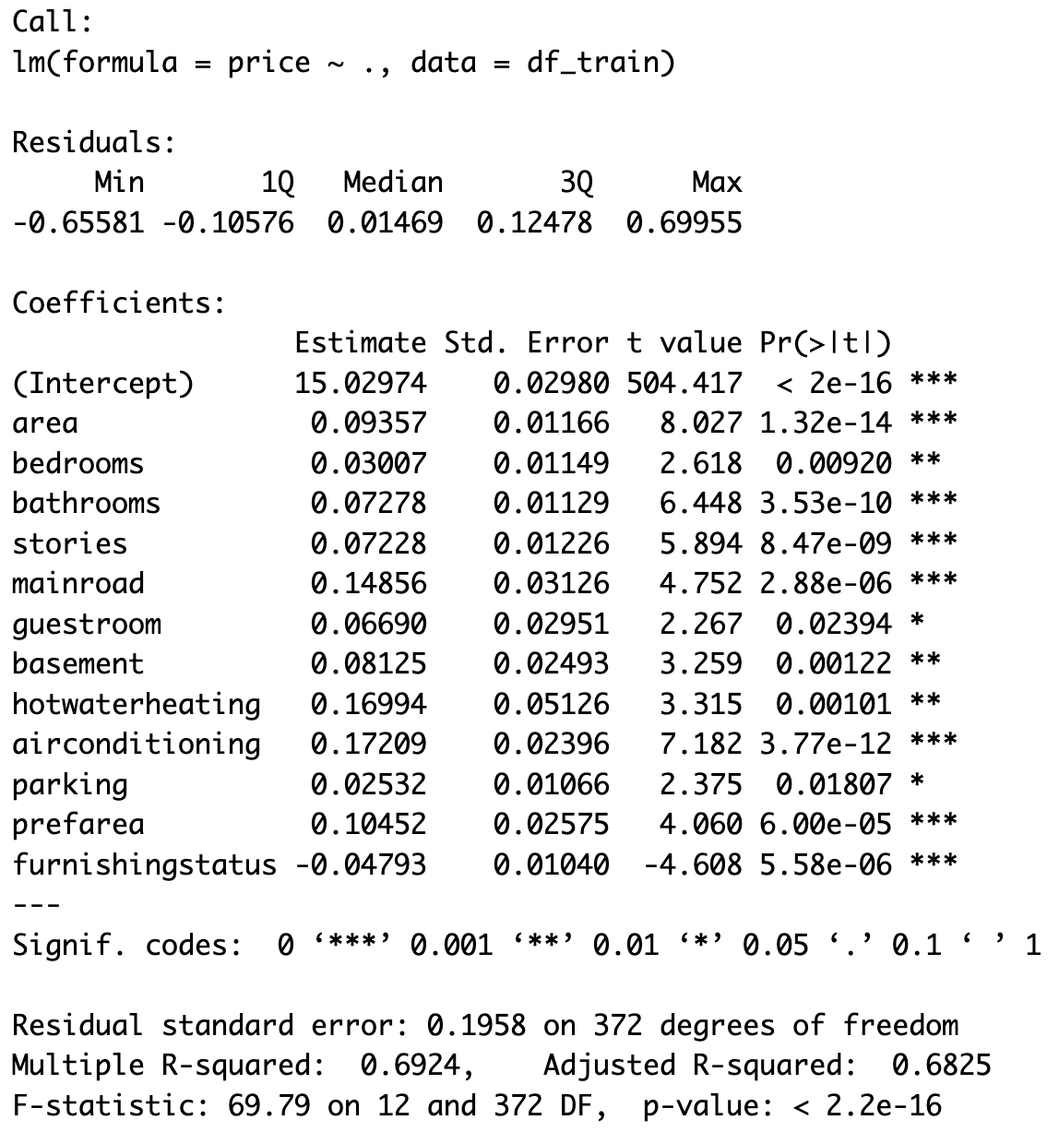
Multiple Linear Regression

Slide 25
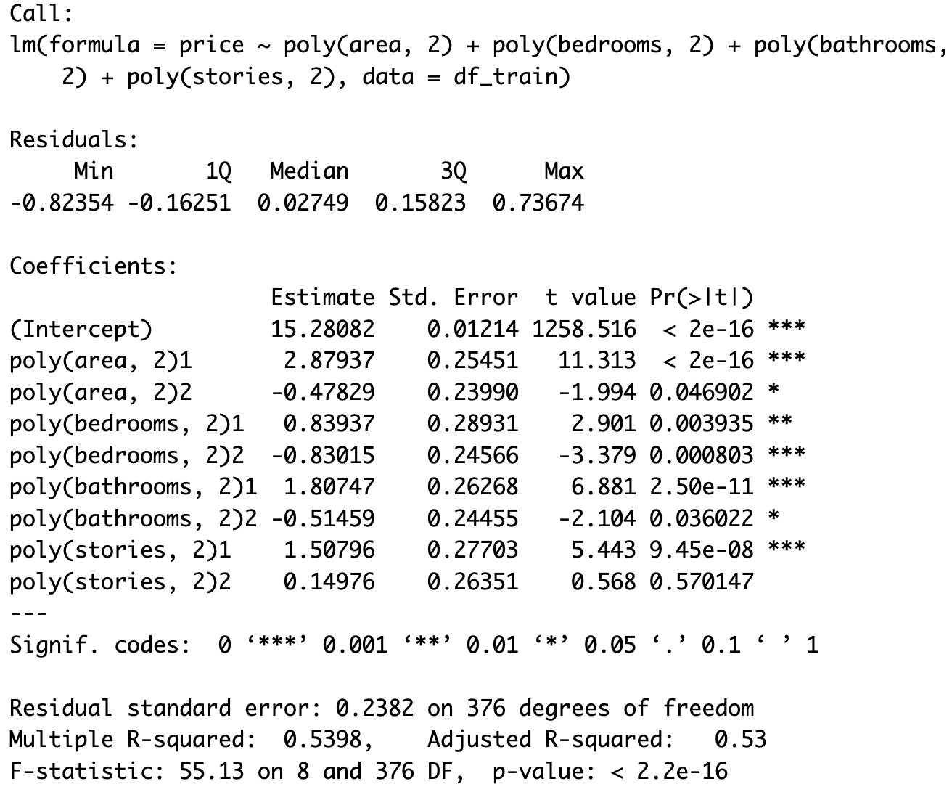
Quadratic Regression

Slide 26
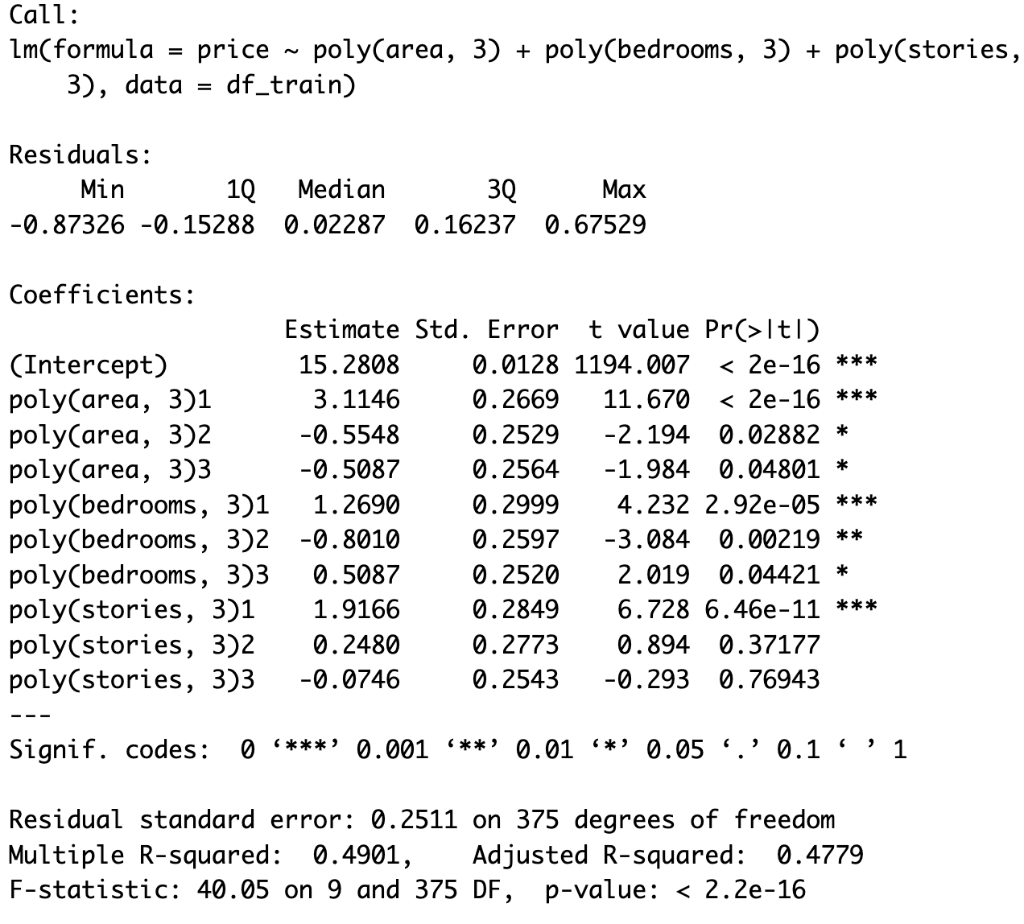
Polynomial Regression

Slide 27
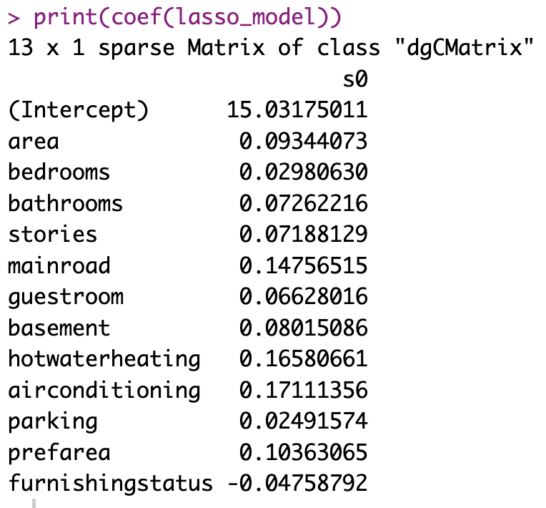
LASSO REGRESSION

Slide 28
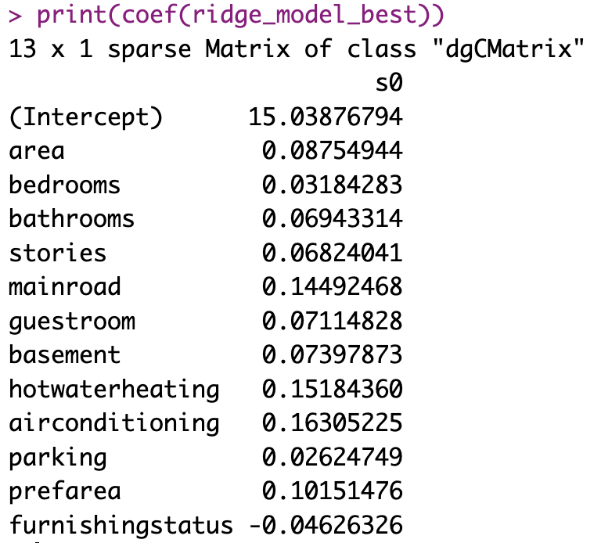
Ridge Regression

Slide 29
Model Validation
Model validation is all about ensuring our model is not just fitting the data well but is actually reliable when faced with new data. In this project, we used model validation techniques to evaluate each of our regression models—like Linear, Ridge, Lasso, and Quadratic Regression. The goal was to find the model that balanced accuracy with generalization, meaning it performed well both on our existing data and on unseen data.
We used metrics like RMSE (Root Mean Squared Error) and R-squared to assess each model’s performance. RMSE helped us understand how far our model’s predictions were from the actual values on average, while R-squared showed us how much of the variation in our data was explained by the model. We combined these metrics with cross-validation, where we split the data into multiple sets and tested the model across them. This way, we were able to spot any model that performed well on the training data but failed on test data. By doing model validation, we gained insights into which model is the most robust and reliable for making predictions on new data.
This approach ultimately guided us in selecting Multiple linear regression model as our preferred model, as it achieved a strong balance between performance and generalization.

Slide 30
Cross validation
Cross-validation is like a “reality check” for our model. Instead of training and testing the model on the same data, we split our data into multiple parts. In this project, we used a method called 5-fold cross-validation. Here’s how it works: we divided the data into five parts. Each time, we trained the model on four parts and tested it on the fifth part. We repeated this five times, switching which part we used for testing each time. By averaging the results, we got a clearer picture of how the model would perform on new, unseen data. This approach helped us avoid overfitting, where the model might look great on training data but struggle on new data. Cross-validation gave us confidence in choosing Multiple linear regression as the most balanced model for our project, showing that it’s likely to perform consistently well in real-world use.

Slide 31
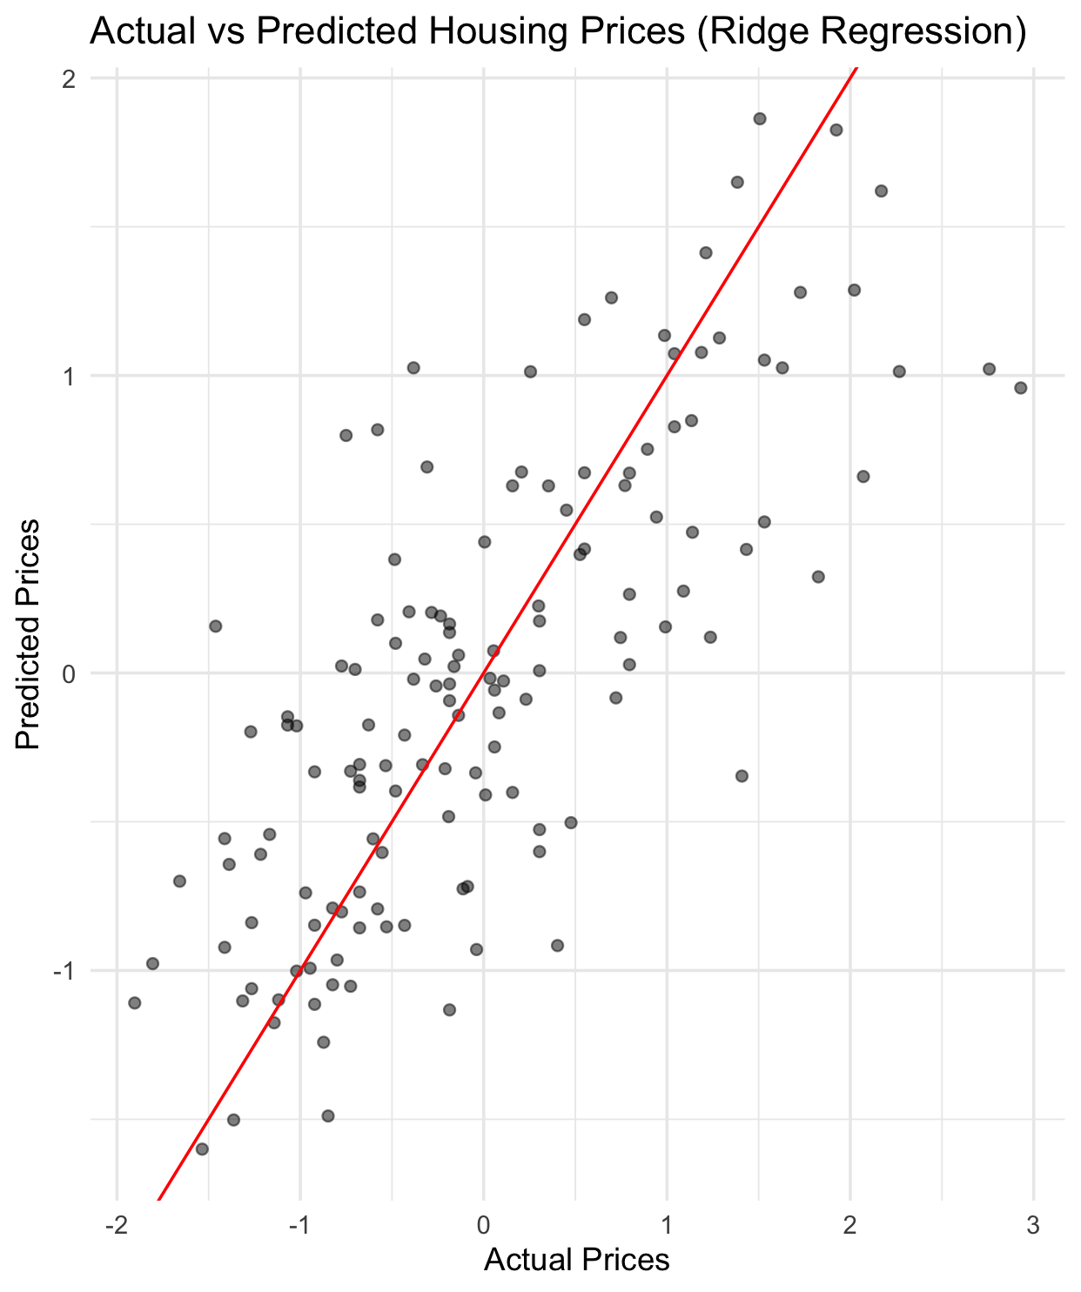
Predicted Prices Vs actual Prices (Multiple Linear Regression model)

Slide 32
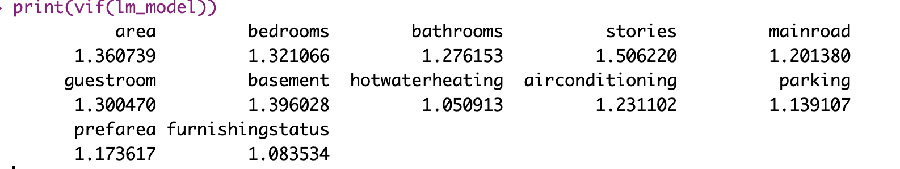
Multicollinearity, VIF
VIF values are all below 2, which suggests that multicollinearity is not a major issue in our model, as VIF values above 5 (or sometimes 10) are typically considered problematic.

Slide 33
Reverse Log Transformation for original price.
Model Predictions on test data are again transformed back to its original values as we applied Log transformation on the price, We reversed it by applying Exponential function on price and then calculated the RMSE.

Slide 34
Model Performance on Test data
Model | RMSE | R-Square | Significance Features
Multiple Linear Regression | 947,670.2 | 0.567 | All Features
Ridge Regression | 943,550.9 | 0.564 | All Features
Lasso Regression | 946,318.7 | 0.567 | All Features
Quadratic Regression | 1,036,016 | 0.470 | Except Stories

Slide 35
Residual Analysis
Residual analysis is crucial in regression modeling because it helps us assess how well the model fits the data and whether the model holds its key assumptions, the four main assumptions are :
1. Mean of Residuals is Zero:
Assumption: The average value of the errors should be zero.
2. Normal Distribution of Residuals
Assumption: The residuals are normally distributed.
3. Constant Standard Deviation (Homoscedasticity)
Assumption: The residuals have a constant variance across all levels of the independent variables.
4. Independence of Residuals:
Assumption: Residuals are independent of each other, meaning that the error for one observation doesn’t depend on or correlate with the error on other.

Slide 36
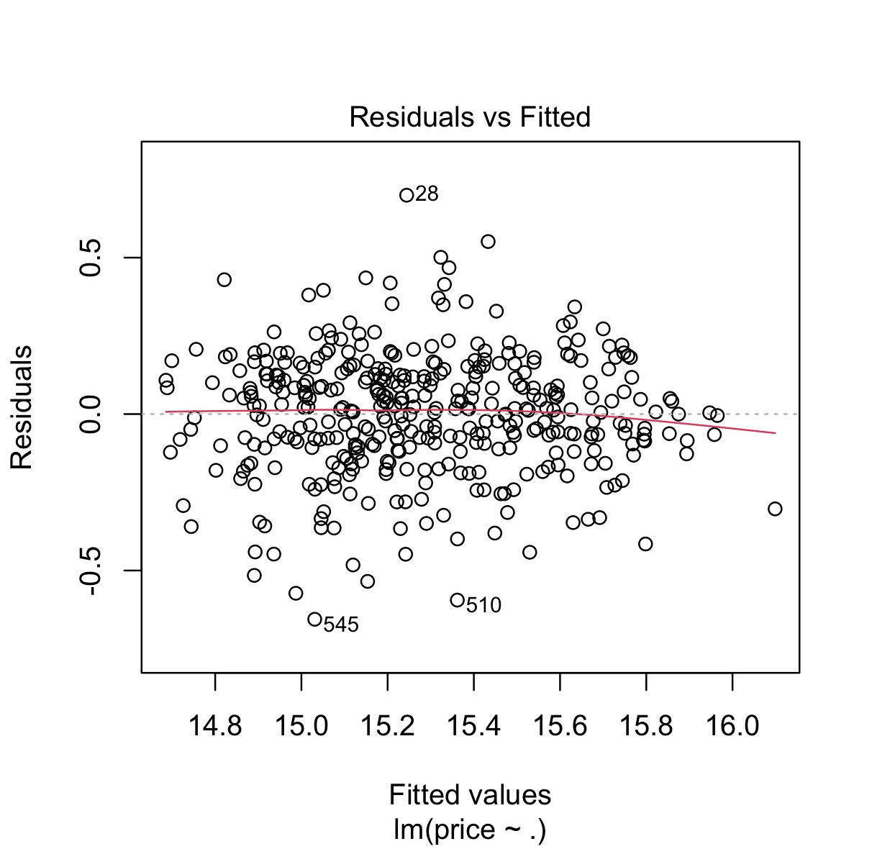
Therefore this plot shows that the multiple linear regression model fits the data fairly well, with residuals mostly centered around zero and randomly scattered. The assumptions of linearity and homoscedasticity seem reasonably satisfied.

Slide 37
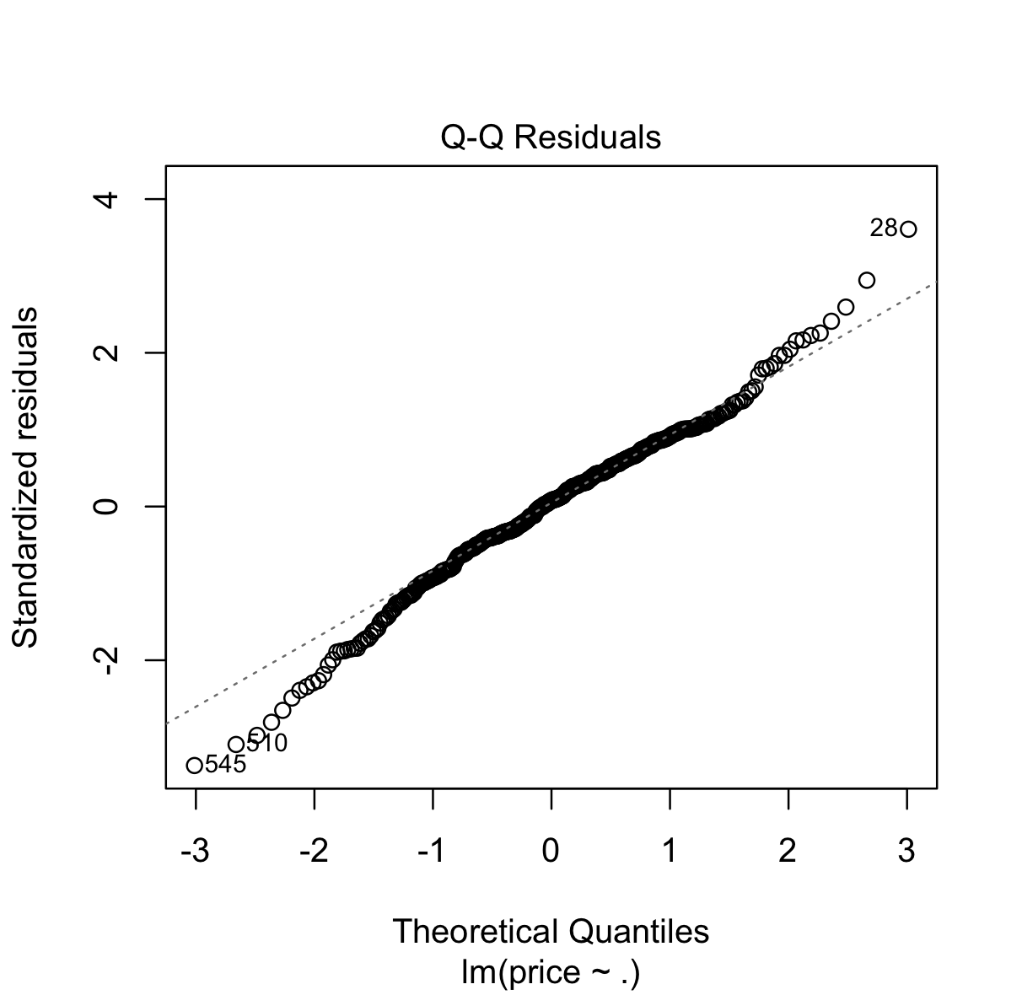
Therefore, The Q-Q plot shows that the residuals of the Multiple linear regression model are approximately normally distributed, as most points closely follow the theoretical quantile line.

Slide 38
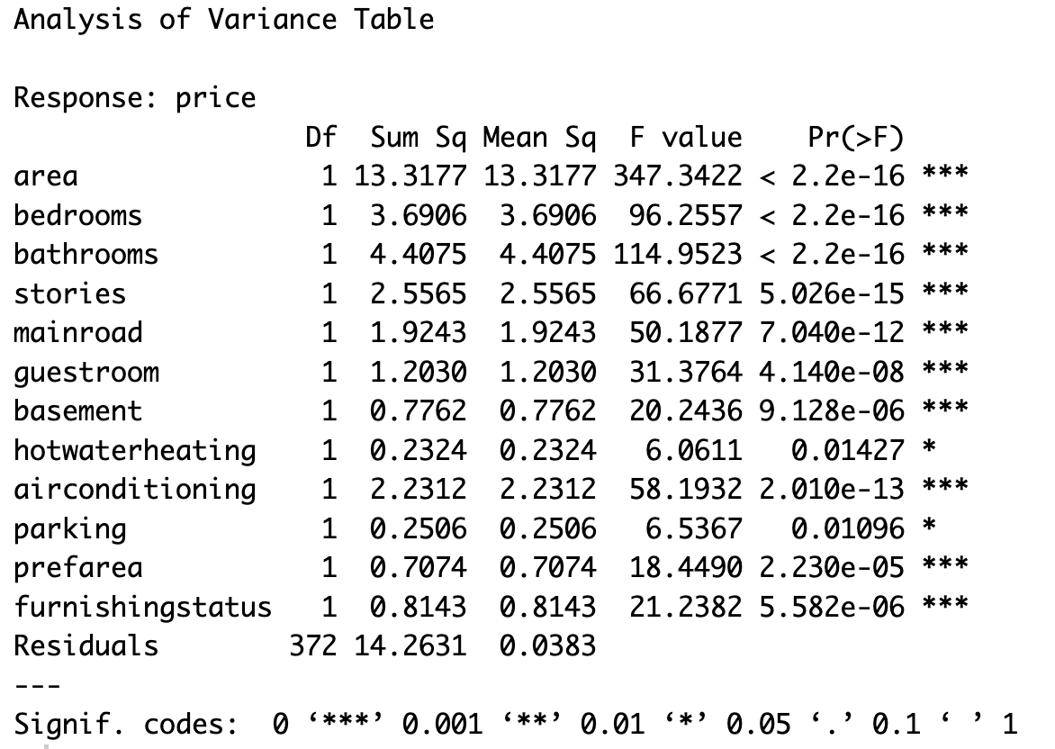
ANOVA: Analysis of Variance
Significant Predictors: Key variables like area, bedrooms, and bathrooms have p-values well below 0.05, indicating strong significance in explaining house price variance, with area being the most impactful.
Less Significant Predictors: Hotwaterheating and parking are statistically significant but less impactful, with p-values between 0.01 and 0.05.
Sum of Squares & F-values: The Sum of Squares indicates the proportion of variance explained by each predictor, with area being the largest, while high F-values for predictors like area demonstrate their strong impact on house prices.

Slide 39
CONCLUSION
Finally, we have completed this regression analysis using the data, achieving fairly good performance from the multiple linear regression model. Most of the features we used are significant, and key model assumptions, such as homoscedasticity, normality, and multicollinearity, are met.
The future scope of this project could include expanding the dataset. With more data points, we could achieve even more accurate results. Additionally, we could explore using different algorithms to further improve performance.

Slide 40
REFERENCES
C. R. Madhuri, G. Anuradha and M. V. Pujitha, "House Price Prediction Using Regression Techniques: A Comparative Study," 2019 International Conference on Smart Structures and Systems (ICSSS), Chennai, India, 2019, pp. 1-5, doi: 10.1109/ICSSS.2019.8882834.
M. Sharma, R. Chauhan, S. Devliyal and K. R. Chythanya, "House Price Prediction Using Linear and Lasso Regression," 2024 3rd International Conference for Innovation in Technology (INOCON), Bangalore, India, 2024, pp. 1-5, doi: 10.1109/INOCON60754.2024.10511592.
https://www.kaggle.com/code/darshandungrani/house-price-prediction-with-ridge-regression

Slide 41
Thank you

